Slide 1
7-IBFE – Two Boundaries: Flapping wings and beam hits circle

Slide 2
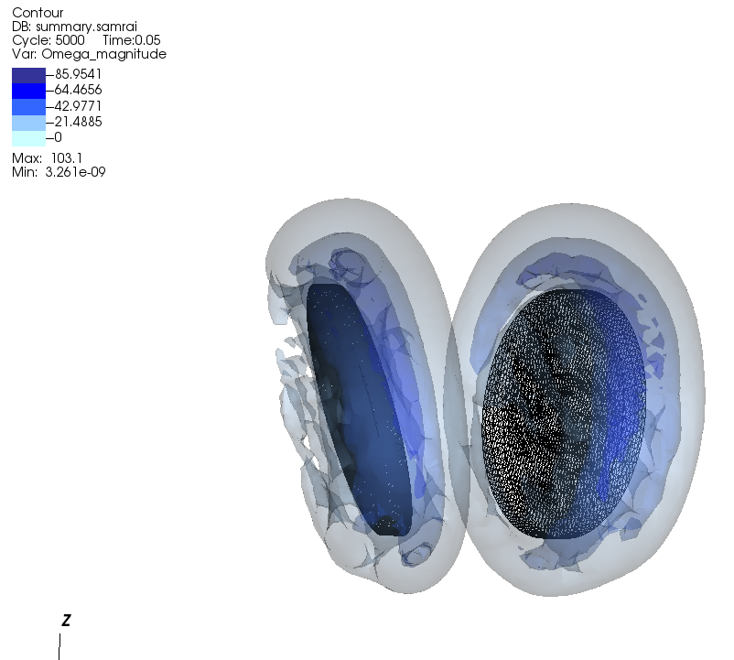
3D flapping wing example
This example shows two elliptical wings performing a simple clap and fling motion.
Two separate meshes are uploaded and moved by target forces with different motions.
The wings were created using Trellis.
This simulation takes a long time to run and generates a lot of data.

Slide 3
Wing set up
Domain size
1x1x1
y_offset =0.008
x_offset = 0.01
wing_chord =0.04
z=0
wing_span = 0.08
z
x=0
z
y
y=0
dx = 1/528 = 0.00189
wing_width (thickness) = 0.00379 (2dx)
x

Slide 4
Make two wings in trellis
I used the trial version of trellis to make 2 elliptical wings with the right dimensions.
I rotated them and translated them to the correct initial positions.
The getting started tutorial was all I needed to learn enough to make the wings in under an hour.
I exported the meshes as exodus .e files, which are in the example folder.

Slide 5
Kinematics of positive wing, sweep angle and angle of attack over time
B=pi/4;
sweep_angle=2.0*pi/3.0;
freq = 1.0;
aoa_not=pi/2;
sweep_angle_pos =0.5*sweep_angle*(1-cos(2*pi*freq*time));
sweep_angle_neg = -0.5*sweep_angle*(1-cos(2*pi*freq*time));
aoa_pos=aoa_not-B*sin(2*pi*freq*time);
aoa_neg=aoa_not+B*sin(2*pi*freq*time);

Slide 6
Kinematics of positive wing
Let s(2) be position along chord and s(0) be position along span in initial configuration
Note s(2)=0 in middle of wing and is along the z-plane, s(0) is along the x-plane
*Note, these equations work for an infinitely thin wing, but shear a wing that has some thickness. Corrected equations
Forthcoming.
Downstroke
s_dump(0) = s(0)*cos(sweep_angle_pos)+((s(2)+0.5*chord_length)*cos(aoa_pos)+s(1))*-sin(sweep_angle_pos) ;
s_dump(1) = ((s(2)+0.5*chord_length)*cos(aoa_pos)+s(1))*cos(sweep_angle_pos)+s(0)*sin(sweep_angle_pos);
s_dump(2) = s(2)*sin(aoa_pos);
Upstroke
s_dump(0) = s(0)*cos(sweep_angle_pos)+(s(2)*cos(aoa_pos)+s(1))*-sin(sweep_angle_pos) ;
s_dump(1) = (s(2)*cos(aoa_pos)+s(1))*cos(sweep_angle_pos)+s(0)*sin(sweep_angle_pos) ;
s_dump(2) = s(2)*sin(aoa_pos);

Slide 7
Some input3d parameters
L = 1.0 // length of the computational (fluid) domain (m)
WSPAN = 0.08 // Span of the wing
RHO = 1000.0 // fluid mass density (kg / m^3)
FREQUENCY = 1.0 //Note this is also set in update_target_positions
RE = 4.0 //Target Re, MU is changed to get the desired RE
MU = RHO*(WSPAN/2.0)*((2.0/3.0)*2.0*3.14*WSPAN*FREQUENCY)/RE // fluid dynamic viscosity (N s / m^2)
CartesianGeometry { //
domain_boxes = [ (0,0,0) , (N - 1,N - 1,N - 1) ] //
x_lo = -L/2, -L/2, -L/2 // lower end of computational domain.
x_up = L/2, L/2, L/2 // upper end of computational domain.
periodic_dimension = 0, 0, 0 //
} //

Slide 8
Create a target force function for each wing
void
target1_force_function(
VectorValue<double>& F,
const TensorValue<double>& /*FF*/,
const libMesh::Point& X,
const libMesh::Point& s,
Elem* const /*elem*/,
const std::vector<const std::vector<double>*>& /*var_data*/,
const std::vector<const std::vector<VectorValue<double> >*>& /*grad_var_data*/,
double time,
void* /*ctx*/)
{
libMesh::Point s_dump;
double kappa;
// s_dump is the target point position
// s is the reference configuration.
// The current position is X

Slide 9
Create a target force function for each wing
void
target2_force_function(
VectorValue<double>& F,
const TensorValue<double>& /*FF*/,
const libMesh::Point& X,
const libMesh::Point& s,
Elem* const /*elem*/,
const std::vector<const std::vector<double>*>& /*var_data*/,
const std::vector<const std::vector<VectorValue<double> >*>& /*grad_var_data*/,
double time,
void* /*ctx*/)
{
libMesh::Point s_dump;
double kappa;
// s_dump is the target point position
// s is the reference configuration.
// The current position is X

Slide 10
Use the same PK1 stress functions
void
PK1_dev_stress_function(
TensorValue<double>& PP,
const TensorValue<double>& FF,
const libMesh::Point& /*X*/,
const libMesh::Point& /*s*/,
Elem* const /*elem*/,
const std::vector<const std::vector<double>*>& /*var_data*/,
const std::vector<const std::vector<VectorValue<double> >*>& /*grad_var_data*/,
double /*time*/,
void* /*ctx*/)
{
PK1_dil_stress_function(
TensorValue<double>& PP,
const TensorValue<double>& FF,
const libMesh::Point& /*X*/,
const libMesh::Point& /*s*/,
Elem* const /*elem*/,
const std::vector<const std::vector<double>*>& /*var_data*/,
const std::vector<const std::vector<VectorValue<double> >*>& /*grad_var_data*/,
double /*time*/,
void* /*ctx*/)
{

Slide 11
Main.C code for two boundaries
// Get various standard options set in the input file.
const string mesh1_exodus_filename = app_initializer->getExodusIIFilename("mesh1");
const string mesh2_exodus_filename = app_initializer->getExodusIIFilename("mesh2");
// Note that boundary condition data must be registered with each FE
// system before calling IBFEMethod::initializeFEData().
Mesh mesh1(init.comm(), NDIM);
Mesh mesh2(init.comm(), NDIM);
mesh1.read("pos_wing.e");
mesh1.prepare_for_use();
mesh2.read("neg_wing.e");
mesh2.prepare_for_use();
vector<MeshBase*> meshes(2);
meshes[0] = &mesh1;
meshes[1] = &mesh2;

Slide 12
Things to change in main.C (under force declarations) (continued…)
IBFEMethod::LagBodyForceFcnData target1_force_data(target1_force_function);
ib_method_ops->registerLagBodyForceFunction(target1_force_data, 0);
IBFEMethod::LagBodyForceFcnData target2_force_data(target2_force_function);
ib_method_ops->registerLagBodyForceFunction(target2_force_data, 1);
IBFEMethod::PK1StressFcnData PK1_dev_stress_data(PK1_dev_stress_function);
IBFEMethod::PK1StressFcnData PK1_dil_stress_data(PK1_dil_stress_function);
ib_method_ops->registerPK1StressFunction(PK1_dev_stress_data, 0);
ib_method_ops->registerPK1StressFunction(PK1_dev_stress_data, 1);
ib_method_ops->registerPK1StressFunction(PK1_dil_stress_data, 0);
ib_method_ops->registerPK1StressFunction(PK1_dil_stress_data, 1);
ib_method_ops->initializeFEEquationSystems();
EquationSystems* mesh1_equation_systems = ib_method_ops->getFEDataManager(0)->getEquationSystems();
EquationSystems* mesh2_equation_systems = ib_method_ops->getFEDataManager(1)->getEquationSystems();
Applied to mesh 0
Applied to mesh 1
Applied to both meshes

Slide 13
ExodusII_IO
These lines
AutoPtr<ExodusII_IO> mesh1_exodus_io(uses_exodus ? new ExodusII_IO(mesh1) : NULL);
AutoPtr<ExodusII_IO> mesh2_exodus_io(uses_exodus ? new ExodusII_IO(mesh2) : NULL);
Should be changed to these lines
std::unique_ptr<ExodusII_IO> mesh1_exodus_io(uses_exodus ? new ExodusII_IO(mesh1) : NULL);
std::unique_ptr<ExodusII_IO> mesh2_exodus_io(uses_exodus ? new ExodusII_IO(mesh2) : NULL);

Slide 14
Postprocess_data function
void postprocess_data(Pointer<PatchHierarchy<NDIM> > /*patch_hierarchy*/,
Pointer<INSHierarchyIntegrator> /*navier_stokes_integrator*/,
Mesh& mesh,
EquationSystems* equation_systems,
const int /*iteration_num*/,
const double loop_time,
const string& /*data_dump_dirname*/)
{
In this function you may need to update the FEBase and Qbase lines
unique_ptr<FEBase> fe(FEBase::build(dim, F_dof_map.variable_type(0)));
unique_ptr<QBase> qrule = QBase::build(QGAUSS, dim, FIFTH);

Slide 15
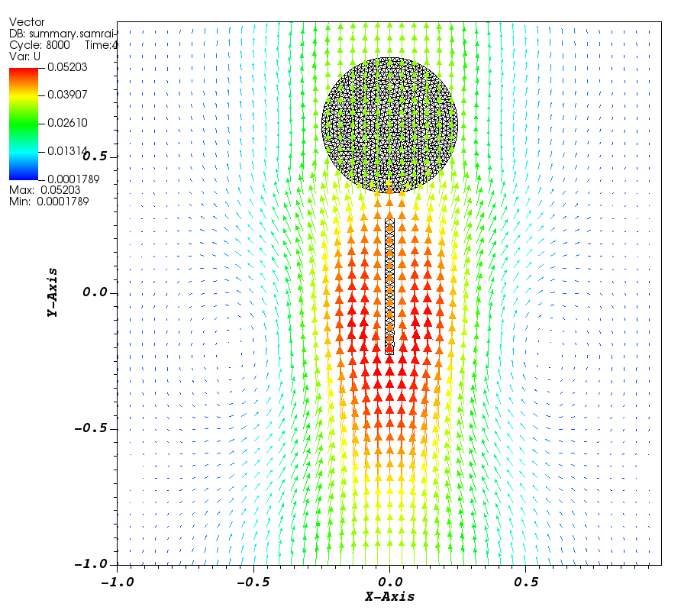
7-IBFE-Plate-Circle
In this example, a 2D beam is propelled towards a 2D circle.
Target points drive the beam for the first 1 second, and then the beam is free to coast.
The circle is untethered and moves due to the approaching beam.

Slide 16
Making the boundaries in Trellis
You have to do a little extra work to make a 2D boundary in Trellis, which can be done through the GUI with some tinkering….
Trelis also provides the capability of writing two-dimensional Genesis databases similar to FASTQ. The user must first assign the appropriate surfaces in the model to an element block. Then a Quad* type element may be specified for the element block. For example
Block 1 Surface 1 To 4 Block 1 Element Type Quad4
In this case, it is important for users to note that a two-dimensional Genesis database will result. In writing a two-dimensional Genesis database, Trelis ignores all z-coordinate data. Therefore, the user must ensure that the Element Block is assigned to a planar surface lying in a plane parallel to the x-y plane. Currently, the Quad* element types are the only supported two-dimensional elements. Two-dimensional shell elements will be added in the near future if required.

Slide 17
Target force function
void
target1_force_function(
VectorValue<double>& F,
const TensorValue<double>& /*FF*/,
const libMesh::Point& X,
const libMesh::Point& s,
Elem* const /*elem*/,
const std::vector<const std::vector<double>*>& /*var_data*/,
const std::vector<const std::vector<VectorValue<double> >*>& /*grad_var_data*/,
double time,
void* /*ctx*/)
{
libMesh::Point s_dump;
if(time<1)
{
s_dump(0)=s(0);
s_dump(1)=s(1)+.25*time;
}
else
{
s_dump(1)=X(1);
s_dump(0)=X(0);
}
F = kappa_s*(s_dump-X);
return;
}

Slide 18
Relevant lines in main.C
// Get various standard options set in the input file.
const string mesh1_exodus_filename = app_initializer->getExodusIIFilename("mesh1");
const string mesh2_exodus_filename = app_initializer->getExodusIIFilename("mesh2");
// Note that boundary condition data must be registered with each FE
// system before calling IBFEMethod::initializeFEData().
Mesh mesh1(init.comm(), NDIM);
Mesh mesh2(init.comm(), NDIM);
mesh1.read("beam.e");
mesh1.prepare_for_use();
mesh2.read("circle.e");
mesh2.prepare_for_use();
vector<MeshBase*> meshes(2);
meshes[0] = &mesh1;
meshes[1] = &mesh2;

Slide 19
Relevant lines in main.C
// Configure the IBFE solver.
ib_method_ops->initializeFEEquationSystems();
IBFEMethod::LagBodyForceFcnData target1_force_data(target1_force_function);
IBFEMethod::PK1StressFcnData PK1_dev_stress_data(PK1_dev_stress_function);
IBFEMethod::PK1StressFcnData PK1_dil_stress_data(PK1_dil_stress_function);
PK1_dev_stress_data.quad_order = Utility::string_to_enum<libMeshEnums::Order>(input_db->getStringWithDefault("PK1_DEV_QUAD_ORDER","THIRD"));
PK1_dil_stress_data.quad_order = Utility::string_to_enum<libMeshEnums::Order>(input_db->getStringWithDefault("PK1_DIL_QUAD_ORDER","FIRST"));
ib_method_ops->registerLagBodyForceFunction(target1_force_data, 0);
ib_method_ops->registerPK1StressFunction(PK1_dev_stress_data, 0);
ib_method_ops->registerPK1StressFunction(PK1_dev_stress_data, 1);
ib_method_ops->registerPK1StressFunction(PK1_dil_stress_data, 0);
ib_method_ops->registerPK1StressFunction(PK1_dil_stress_data, 1);
EquationSystems* mesh1_equation_systems = ib_method_ops->getFEDataManager(0)->getEquationSystems(); EquationSystems* mesh2_equation_systems = ib_method_ops->getFEDataManager(1)->getEquationSystems();

Slide 20
Other changes from earlier versions
These lines
AutoPtr<ExodusII_IO> mesh1_exodus_io(uses_exodus ? new ExodusII_IO(mesh1) : NULL);
AutoPtr<ExodusII_IO> mesh2_exodus_io(uses_exodus ? new ExodusII_IO(mesh2) : NULL);
Should be changed to these lines
std::unique_ptr<ExodusII_IO> mesh1_exodus_io(uses_exodus ? new ExodusII_IO(mesh1) : NULL);
std::unique_ptr<ExodusII_IO> mesh2_exodus_io(uses_exodus ? new ExodusII_IO(mesh2) : NULL);

